Slide 1
PRAVEENA R
FINAL PROJECT
3/21/2024 Annual Review

Slide 2
Time-Series Forecasting with Autoencoders
PROJECT TITLE
3/21/2024 Annual Review

Slide 3


AGENDA
PROBLEM STATEMENT
PROJECT OVERVIEW
WHO ARE THE END USERS?
SOLUTION
WOW IN THE SOLUTION
MODEL
RESULT
3/21/2024 Annual Review

Slide 4

PROBLEM STATEMENT
The project aims to develop an autoencoder-based approach for time-series forecasting, focusing on capturing temporal dependencies and patterns within the data to generate accurate predictions of future data points. By leveraging the power of autoencoders, the goal is to address the challenge of forecasting in dynamic and evolving time-series datasets.
3/21/2024 Annual Review

Slide 5

PROJECT OVERVIEW
This project explores the application of autoencoders in time-series forecasting, aiming to develop a model capable of capturing intricate temporal patterns within sequential data. By encoding and decoding time-series data, the autoencoder facilitates accurate predictions of future values, offering insights into future trends and behavior.
3/21/2024 Annual Review

Slide 6

WHO ARE THE END USERS?
Financial Analysts: Utilize the autoencoder-based time-series forecasting model to predict stock prices, currency exchange rates, or other financial metrics, aiding in investment decision-making.
Energy Sector Professionals: Employ the model to forecast energy consumption patterns, optimize energy production, and plan resource allocation for improved efficiency and sustainability.
3/21/2024 Annual Review

Slide 7

YOUR SOLUTION AND ITS VALUE PROPOSITION
The project involves generating synthetic time-series data, creating and training an autoencoder model, and evaluating its performance. The value proposition lies in the ability of the autoencoder to capture temporal patterns within the data and generate accurate predictions of future values. This solution offers insights into future trends and behavior, facilitating informed decision-making in various domains such as finance, energy, and healthcare.
3/21/2024 Annual Review

Slide 8
THE WOW IN YOUR SOLUTION
The project stands out by leveraging autoencoders to effectively capture intricate temporal patterns in time-series data, enabling accurate forecasting of future values. Autoencoders excel in learning meaningful representations from sequential data, facilitating better understanding and prediction of complex temporal dynamics. By providing precise forecasts, the project aids in decision-making across various domains, offering insights into future trends and optimizing resource allocation. The advantages include improved accuracy, scalability, and interpretability of forecasts, empowering stakeholders with actionable insights for informed planning and decision-making.
3/21/2024 Annual Review

Slide 9
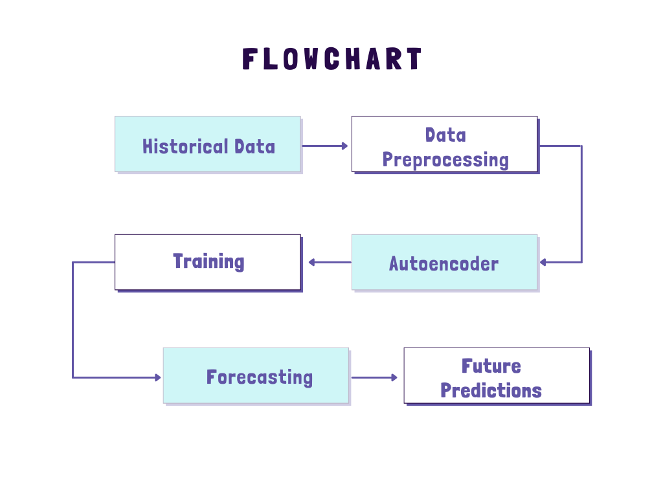
MODELLING
3/21/2024 Annual Review

Slide 10
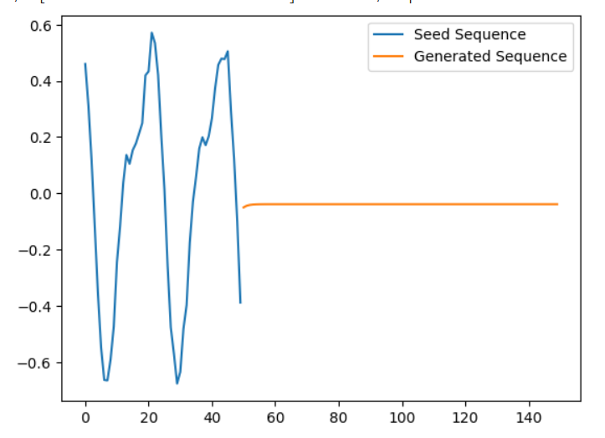
RESULTS
The project's results demonstrate the autoencoder's ability to accurately forecast future values in time-series data, showcasing its effectiveness in capturing temporal patterns and generating precise predictions.
https://drive.google.com/file/d/1E2lLc1FGSRKmYAylv0-BC-nsH2qHvzf7/view?usp=sharing
3/21/2024 Annual Review

